Slide 1

Analysis of the reduced Hodgkin-Huxley equations
What are the Hodgkin-Huxley equations?
Why use the reduced form?
How was the analysis carried out?
What results?
What conclusions?

Slide 2
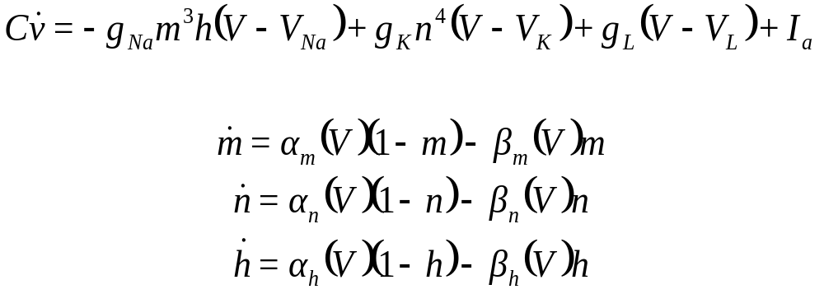
What are the HH Equations?
Calculated by Alan Hodgkin and Andrew Huxley in 1952.
A mathematical model for the generation of action potentials across an axon.
Based on the dynamical interplay between ionic conductances and electrical activity.
Numerically fitted coefficients.

Slide 3
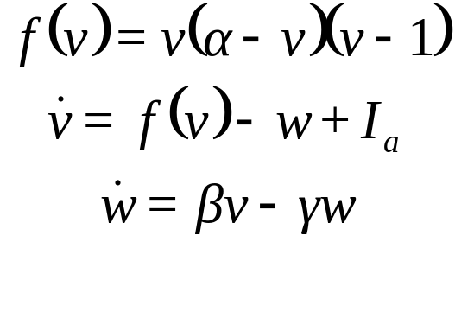
Why do we reduce?
This is a 4-Dimensional system of coupled equations, very difficult to analyse.
The timescales of the gating variables n, m and h are different.
m changes so fast as to be negligible, h can be set to a constant.
We now are left with a 2-Dimensional system of coupled equations
This is the FitzHugh-Nagumo model, approximates the dynamics of the HH model quite well.

Slide 4
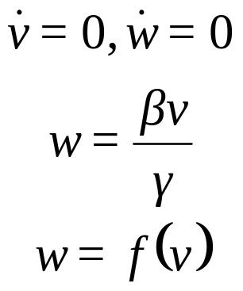
How we carried out the analysis?
Calculated the Nullclines of the FHN equations to determine the phase space of the system.
Nullclines are where the rate of change is zero.
Kept the applied current constant initially, I_{a}.
Varied the initial values of v, w and the parameters α, β and γ.
Then varied the applied current, I_{a}.
Applied short burts of current.

Slide 5
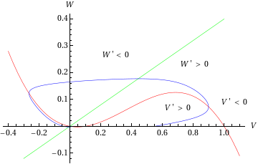
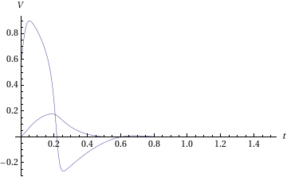
Results A
Existence of 1 stable soultion
Canard Behaviour

Slide 6
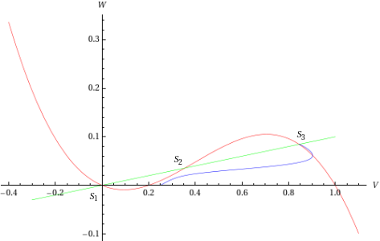
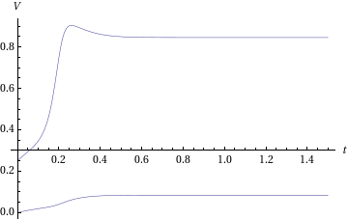
Results B
Existence of 3 solutions.
2 are stable but excitable.
1 is unstable.

Slide 7
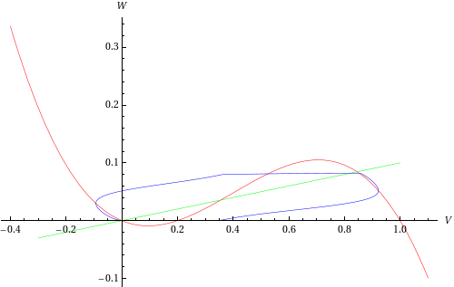
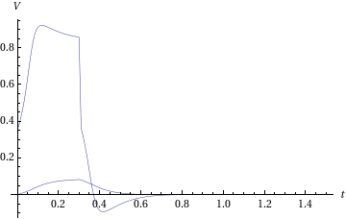
Results C
Switching behaviour.
A short burst of current enacts the switch:

Slide 8
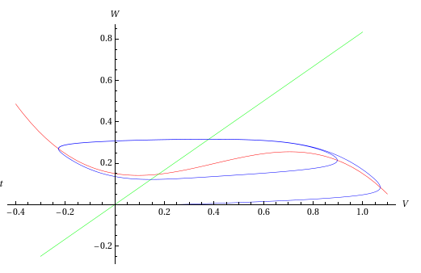
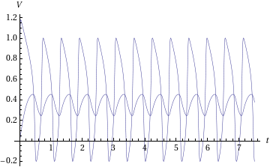
Results D
Limit Cycle Periodic Solutions for a small window of applied currents.
Periodic Neuron Firing:

Slide 9
Conclusions?
Canards exist in the reduced HH system.
Leads to a dramatic change in the properties of a control parameter over a narrow time interval.
Periodic solutions exist within a small range of the bifurcation parameter, leading to 'spike trains'.
A sufficiently large, but short lived current can induce switching behaviour.
Hodgkin, A. L., Huxley, A. F.: A quantitative description of membrane current and its application to conduction and excitation in nerve. J. Physiol. 117, pp. 500-544 (1952)
(2) Murray, J.D: Mathematical Biology. Biomathematics Vol. 19 (1989)
(3)Moehlis, J: Canards for a reduction of the Hodgkin-Huxley equations. J.Math.Bio, 52, pp.141-153 (2006)

